Slide 1

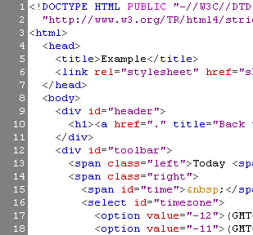


HTML Basics
HTML, Text, Images, Tables

Slide 2
Introduction to HTML
How the Web Works?
What is a Web Page?
My First HTML Page
Basic Tags: Hyperlinks, Images, Formatting
Headings and Paragraphs
HTML in Details
The <!DOCTYPE> Declaration
The <head> Section: Title, Meta, Script, Style

Slide 3
HTML in Details
The <body> Section
Text Styling and Formatting Tags
Hyperlinks: <a>, Hyperlinks and Sections
Images: <img>
Lists: <ol>, <ul> and <dl>
The <div> and <span> elements
HTML Tables
HTML Forms

Slide 4



How the Web Works?
WWW use classical client / server architecture
HTTP is text-based request-response protocol
HTTP
Page request
HTTP
Server response
Server running Web Server Software (IIS, Apache, etc.)
Client running a Web Browser

Slide 5
What is a Web Page?
Web pages are text files containing HTML
HTML – Hyper Text Markup Language
A notation for describing
document structure (semantic markup)
formatting (presentation markup)
Looks (looked?) like:
A Microsoft Word document
The markup tags provide information about the page content structure

Slide 6
Creating HTML Pages
An HTML file must have an .htm or .html file extension
HTML files can be created with text editors:
NotePad, NotePad ++, PSPad
Or HTML editors
Microsoft FrontPage
Macromedia Dreamweaver
Netscape Composer
Microsoft Word
Visual Studio

Slide 7



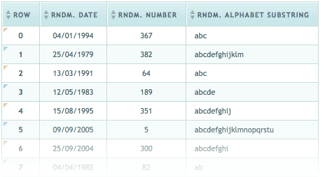

HTML Basics
Text, Images, Tables, Forms

Slide 8
HTML Structure
HTML is comprised of “elements” and “tags”
Begins with <html> and ends with </html>
Elements (tags) are nested one inside another:
Tags have attributes:
HTML describes structure using two main sections: <head> and <body>
<html> <head></head> <body></body> </html>
<img src="logo.jpg" alt="logo" />

Slide 9
HTML Code Formatting
The HTML source code should be formatted to increase readability and facilitate debugging.
Every block element should start on a new line.
Every nested (block) element should be indented.
Browsers ignore multiple whitespaces in the page source, so formatting is harmless.

Slide 10
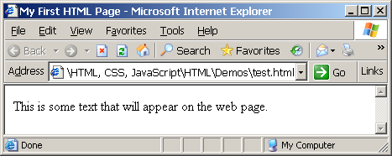
First HTML Page
test.html
<html>
<head>
<title>My First HTML Page</title>
</head>
<body>
<p>This is some text...</p>
</body>
</html>

Slide 11
First HTML Page: Tags
<html>
<head>
<title>My First HTML Page</title>
</head>
<body>
<p>This is some text...</p>
</body>
</html>
Opening tag
Closing tag
An HTML element consists of an opening tag, a closing tag and the content inside.

Slide 12
First HTML Page: Header
HTML header
<html>
<head>
<title>My First HTML Page</title>
</head>
<body>
<p>This is some text...</p>
</body>
</html>

Slide 13
First HTML Page: Body
<html>
<head>
<title>My First HTML Page</title>
</head>
<body>
<p>This is some text...</p>
</body>
</html>
HTML body

Slide 14
Some Simple Tags
Hyperlink Tags
Image Tags
Text formatting tags
<a href="http://www.telerik.com/"
title="Telerik">Link to Telerik Web site</a>
<img src="logo.gif" alt="logo" />
This text is <em>emphasized.</em>
<br />new line<br />
This one is <strong>more emphasized.</strong>

Slide 15
Some Simple Tags – Example
some-tags.html
<html>
<head>
<title>Simple Tags Demo</title>
</head>
<body>
<a href="http://www.telerik.com/" title=
"Telerik site">This is a link.</a>
<br />
<img src="logo.gif" alt="logo" />
<br />
<strong>Bold</strong> and <em>italic</em> text.
</body>
</html>

Slide 16
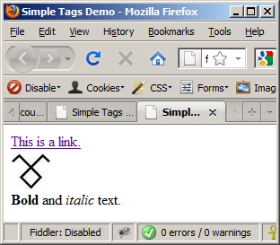
Some Simple Tags
some-tags.html
<!DOCTYPE HTML>
<html>
<head>
<title>Simple Tags Demo</title>
</head>
<body>
<a href="http://www.telerik.com/" title=
"Telerik site">This is a link.</a>
<br />
<img src="logo.gif" alt="logo" />
<br />
<strong>Bold</strong> and <em>italic</em> text.
</body>
</html>

Slide 17
Tags Attributes
Tags can have attributes
Attributes specify properties and behavior
Example:
Few attributes can apply to every element:
id, style, class, title
The id is unique in the document
Content of title attribute is displayed as hint when the element is hovered with the mouse
Some elements have obligatory attributes
Attribute alt with value "logo"
<img src="logo.gif" alt="logo" />

Slide 18
Headings and Paragraphs
Heading Tags (h1 – h6)
Paragraph Tags
Sections: div and span
<h1>Heading 1</h1>
<h2>Sub heading 2</h2>
<h3>Sub heading 3</h3>
<p>This is my first paragraph</p>
<p>This is my second paragraph</p>
<div style="background: skyblue;">
This is a div</div>

Slide 19
Headings and Paragraphs – Example
headings.html
<html>
<head><title>Headings and paragraphs</title></head>
<body>
<h1>Heading 1</h1>
<h2>Sub heading 2</h2>
<h3>Sub heading 3</h3>
<p>This is my first paragraph</p>
<p>This is my second paragraph</p>
<div style="background:skyblue">
This is a div</div>
</body>
</html>

Slide 20
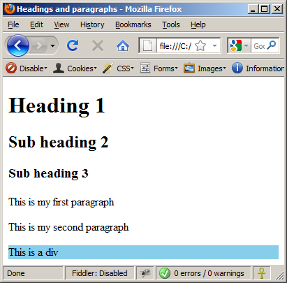
Headings and Paragraphs – Example (2)
headings.html
<html>
<head><title>Headings and paragraphs</title></head>
<body>
<h1>Heading 1</h1>
<h2>Sub heading 2</h2>
<h3>Sub heading 3</h3>
<p>This is my first paragraph</p>
<p>This is my second paragraph</p>
<div style="background:skyblue">
This is a div</div>
</body>
</html>

Slide 21
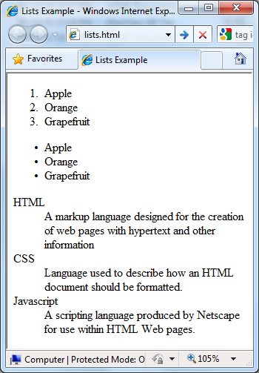
Lists – Example
lists.html
<ol type="1">
<li>Apple</li>
<li>Orange</li>
<li>Grapefruit</li>
</ol>
<ul type="disc">
<li>Apple</li>
<li>Orange</li>
<li>Grapefruit</li>
</ul>
<dl>
<dt>HTML</dt>
<dd>A markup lang…</dd>
</dl>

Slide 22
HTML Tables
Tables represent tabular data
A table consists of one or several rows
Each row has one or more columns
Tables comprised of several core tags: <table></table>: begin / end the table <tr></tr>: create a table row <td></td>: create tabular data (cell)

Slide 23
HTML Tables
Start and end of a table
Start and end of a row
Start and end of a cell in a row
<table> ... </table>
<tr> ... </tr>
<td> ... </td>

Slide 24
Simple HTML Tables – Example
<table cellspacing="0" cellpadding="5">
<tr>
<td><img src="ppt.gif"></td>
<td><a href="lecture1.ppt">Lecture 1</a></td>
</tr>
<tr>
<td><img src="ppt.gif"></td>
<td><a href="lecture2.ppt">Lecture 2</a></td>
</tr>
<tr>
<td><img src="zip.gif"></td>
<td><a href="lecture2-demos.zip">
Lecture 2 - Demos</a></td>
</tr>
</table>

Slide 25
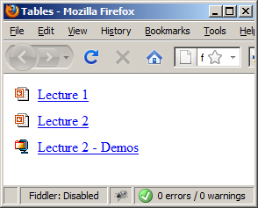
Simple HTML Tables – Example (2)
<table cellspacing="0" cellpadding="5">
<tr>
<td><img src="ppt.gif"></td>
<td><a href="lecture1.ppt">Lecture 1</a></td>
</tr>
<tr>
<td><img src="ppt.gif"></td>
<td><a href="lecture2.ppt">Lecture 2</a></td>
</tr>
<tr>
<td><img src="zip.gif"></td>
<td><a href="lecture2-demos.zip">
Lecture 2 - Demos</a></td>
</tr>
</table>

Slide 26
Complete HTML Tables
Table rows split into three semantic sections: header, body and footer
<thead> denotes table header and contains <th> elements, instead of <td> elements
<tbody> denotes collection of table rows that contain the very data
<tfoot> denotes table footer but comes BEFORE the <tbody> tag
<colgroup> and <col> define columns (most often used to set column widths)

Slide 27
Complete HTML Table: Example
<table>
<colgroup>
<col style="width:100px" /><col />
</colgroup>
<thead>
<tr><th>Column 1</th><th>Column 2</th></tr>
</thead>
<tfoot>
<tr><td>Footer 1</td><td>Footer 2</td></tr>
</tfoot>
<tbody>
<tr><td>Cell 1.1</td><td>Cell 1.2</td></tr>
<tr><td>Cell 2.1</td><td>Cell 2.2</td></tr>
</tbody>
</table>
columns
header
th
footer
Last comes the body (data)

Slide 28
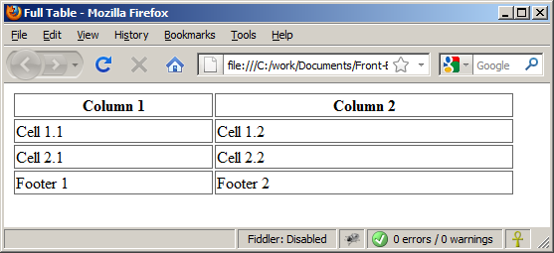
Complete HTML Table:
By default, header text is bold and centered.
table-full.html
<table>
<colgroup>
<col style="width:200px" /><col />
</colgroup>
<thead>
<tr><th>Column 1</th><th>Column 2</th></tr>
</thead>
<tfoot>
<tr><td>Footer 1</td><td>Footer 2</td></tr>
</tfoot>
<tbody>
<tr><td>Cell 1.1</td><td>Cell 1.2</td></tr>
<tr><td>Cell 2.1</td><td>Cell 2.2</td></tr>
</tbody>
</table>
Although the footer is before the data in the code, it is displayed last

Slide 29
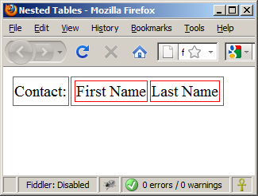
Nested Tables
Table data “cells” (<td>) can contain nested tables (tables within tables):
nested-tables.html
<table>
<tr>
<td>Contact:</td>
<td>
<table>
<tr>
<td>First Name</td>
<td>Last Name</td>
</tr>
</table>
</td>
</tr>
</table>

